Slide 1


MTU AND FRAGMENTATION
By Yashmitha Sri|AP21110010678
SRM University,AP

Slide 2

INTRODUCTION
Computer networks are the backbone of modern communication, connecting devices and enabling the transfer of data.
Networks come in various forms, from local area networks (LANs) within homes and offices to vast global networks like the internet.
The efficient exchange of data in these networks is crucial for communication, and understanding concepts like MTU and fragmentation is essential for optimizing this data transfer.

Slide 3
MTU
MTU, short for Maximum Transmission Unit, is a fundamental concept in computer networking that defines maximum size of a data unit that can be transmitted over a particular network or link-layer protocol.
Each link-layer protocol, like Ethernet, has its own defined MTU. For standard Ethernet, the MTU is typically 1500 bytes. This means that if a datagram (a packet of data) is larger than 1500 bytes, it must be fragmented into smaller pieces for transmission over an Ethernet network.

Slide 4
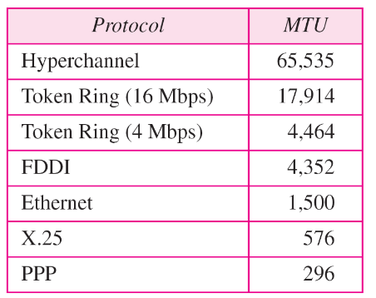

Slide 5
FRAGMENTATION DEFINED
Fragmentation is the process of dividing a large data packet into smaller fragments for transmission when the packet's size exceeds the network's MTU.
Each fragment is individually sent over the network and reassembled at the destination.
This process is essential for transmitting large files over networks with smaller MTUs.

Slide 6
FRAGMENTATION DEFINED
Datagram fragmentation can be performed by either the source host that initially creates the datagram or by any router in the path between the source and destination.
Regardless of where the fragmentation occurs, the reassembly of the fragmented datagram is only done by the destination host. This is because only the destination knows the correct order and structure of the original datagram.

Slide 7

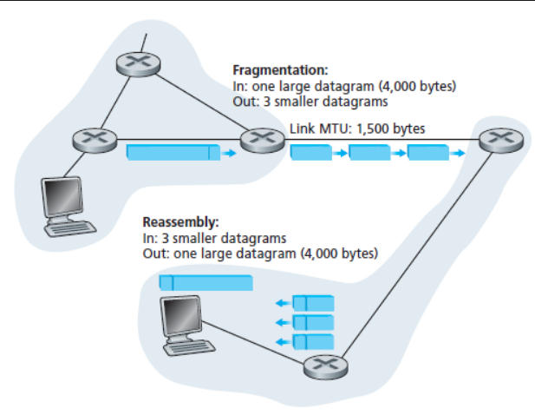

Slide 8
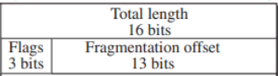
FIELDS TO MODIFY
When a datagram is fragmented, the host or router performing the fragmentation must modify specific fields in the headers of the fragments.
Reserved : The leftmost bit is reserved (not used).
Do not fragment : if it is 1 => the datagram cannot be fragmented;If it cannot pass the datagram through any available physical network, it discards the datagram and sends an error message to the source host.
0 => the datagram can be fragmented if necessary.
More fragment : If its value is 1, it means the datagram is not the last fragment; there are more fragments after this one.if not its the last.

Slide 9
Fragment offset : 13-bit fragmentation offset field shows the relative position of this fragment with respect to the whole datagram.
1. The first fragment has an offset field value of zero.
2. Divide the length of the first fragment by 8(offset value is measured in units of 8 bytes). The second fragment has an offset value equal to that result.
3. Divide the total length of the first and second fragment by 8. The third fragment has an offset value equal to that result.
4. Continue the process. The last fragment has its MF bit set to 0.

Slide 10
Numerical:
Let's consider a scenario where a large datagram needs to be fragmented into smaller fragments due to the Maximum Transfer Unit (MTU) limitations of a network. The original datagram is 2000 bytes long, and the MTU of the network is 500 bytes.

Slide 11
Fragment 1: | Data (500 bytes) | Offset = 0 | MF = 1
Fragment 2: | Data (500 bytes) | Offset = 62 | MF = 1
Fragment 3: | Data (500 bytes) | Offset = 125 | MF = 1
Fragment 4: | Data (500 bytes) | Offset = 187 | MF = 0

Slide 12
In an IPv4 packet, the value of HLEN is 1000 in binary. How many bytes of options are being carried by this packet?

Slide 13
Solution
The HLEN field in an IPv4 header specifies the length of the header in 32-bit words. So, when HLEN is 1000 in binary, it means the header length is 8 (in decimal).
Each 32-bit word consists of 4 bytes (8 bits per byte). Therefore, the correct calculation for the total header length in bytes is:
HLEN (in 32-bit words) * 4 bytes per word = 8 * 4 = 32 bytes.
So, the IPv4 header in this case is 32 bytes long. The first 20 bytes are the base header, and the remaining 12 bytes are used for options.

Slide 14
REAL-WORLD EXAMPLES
Streaming Services (Netflix, YouTube, etc.)
Gaming
VoIP (Voice over IP) and Real-Time Communication
Satellite TV and Radio

Slide 15
CHALLENGES OF FRAGMENTATION
Latency: Fragmentation can increase latency, as packets take longer to traverse the network due to the need for reassembly.(overhead and additional processing)
Some firewalls and security measures can interfere with fragmented packets
Packet Loss: Fragmentation can lead to packet loss and retransmissions, which can significantly impact network performance.
Therefore, efficient MTU management is essential, along with a clear understanding of fragmentation's challenges, to ensure that network security measures function optimally without compromising data transmission.

Slide 16
BEST PRACTICES
Careful Consideration for Optimal MTU Size.
Consistency in MTU sizes : When all devices within the network adhere to the same MTU size, fragmentation can be minimized.
Minimizing Complications: By employing Path MTU Discovery, devices ensure that data packets are appropriately sized for the network's MTU.
Dynamic MTU Management: MTU settings should not be treated as static parameters. They require periodic review and adjustment to ensure they remain in alignment with evolving network requirements and changes.

Slide 17



